Slide 1
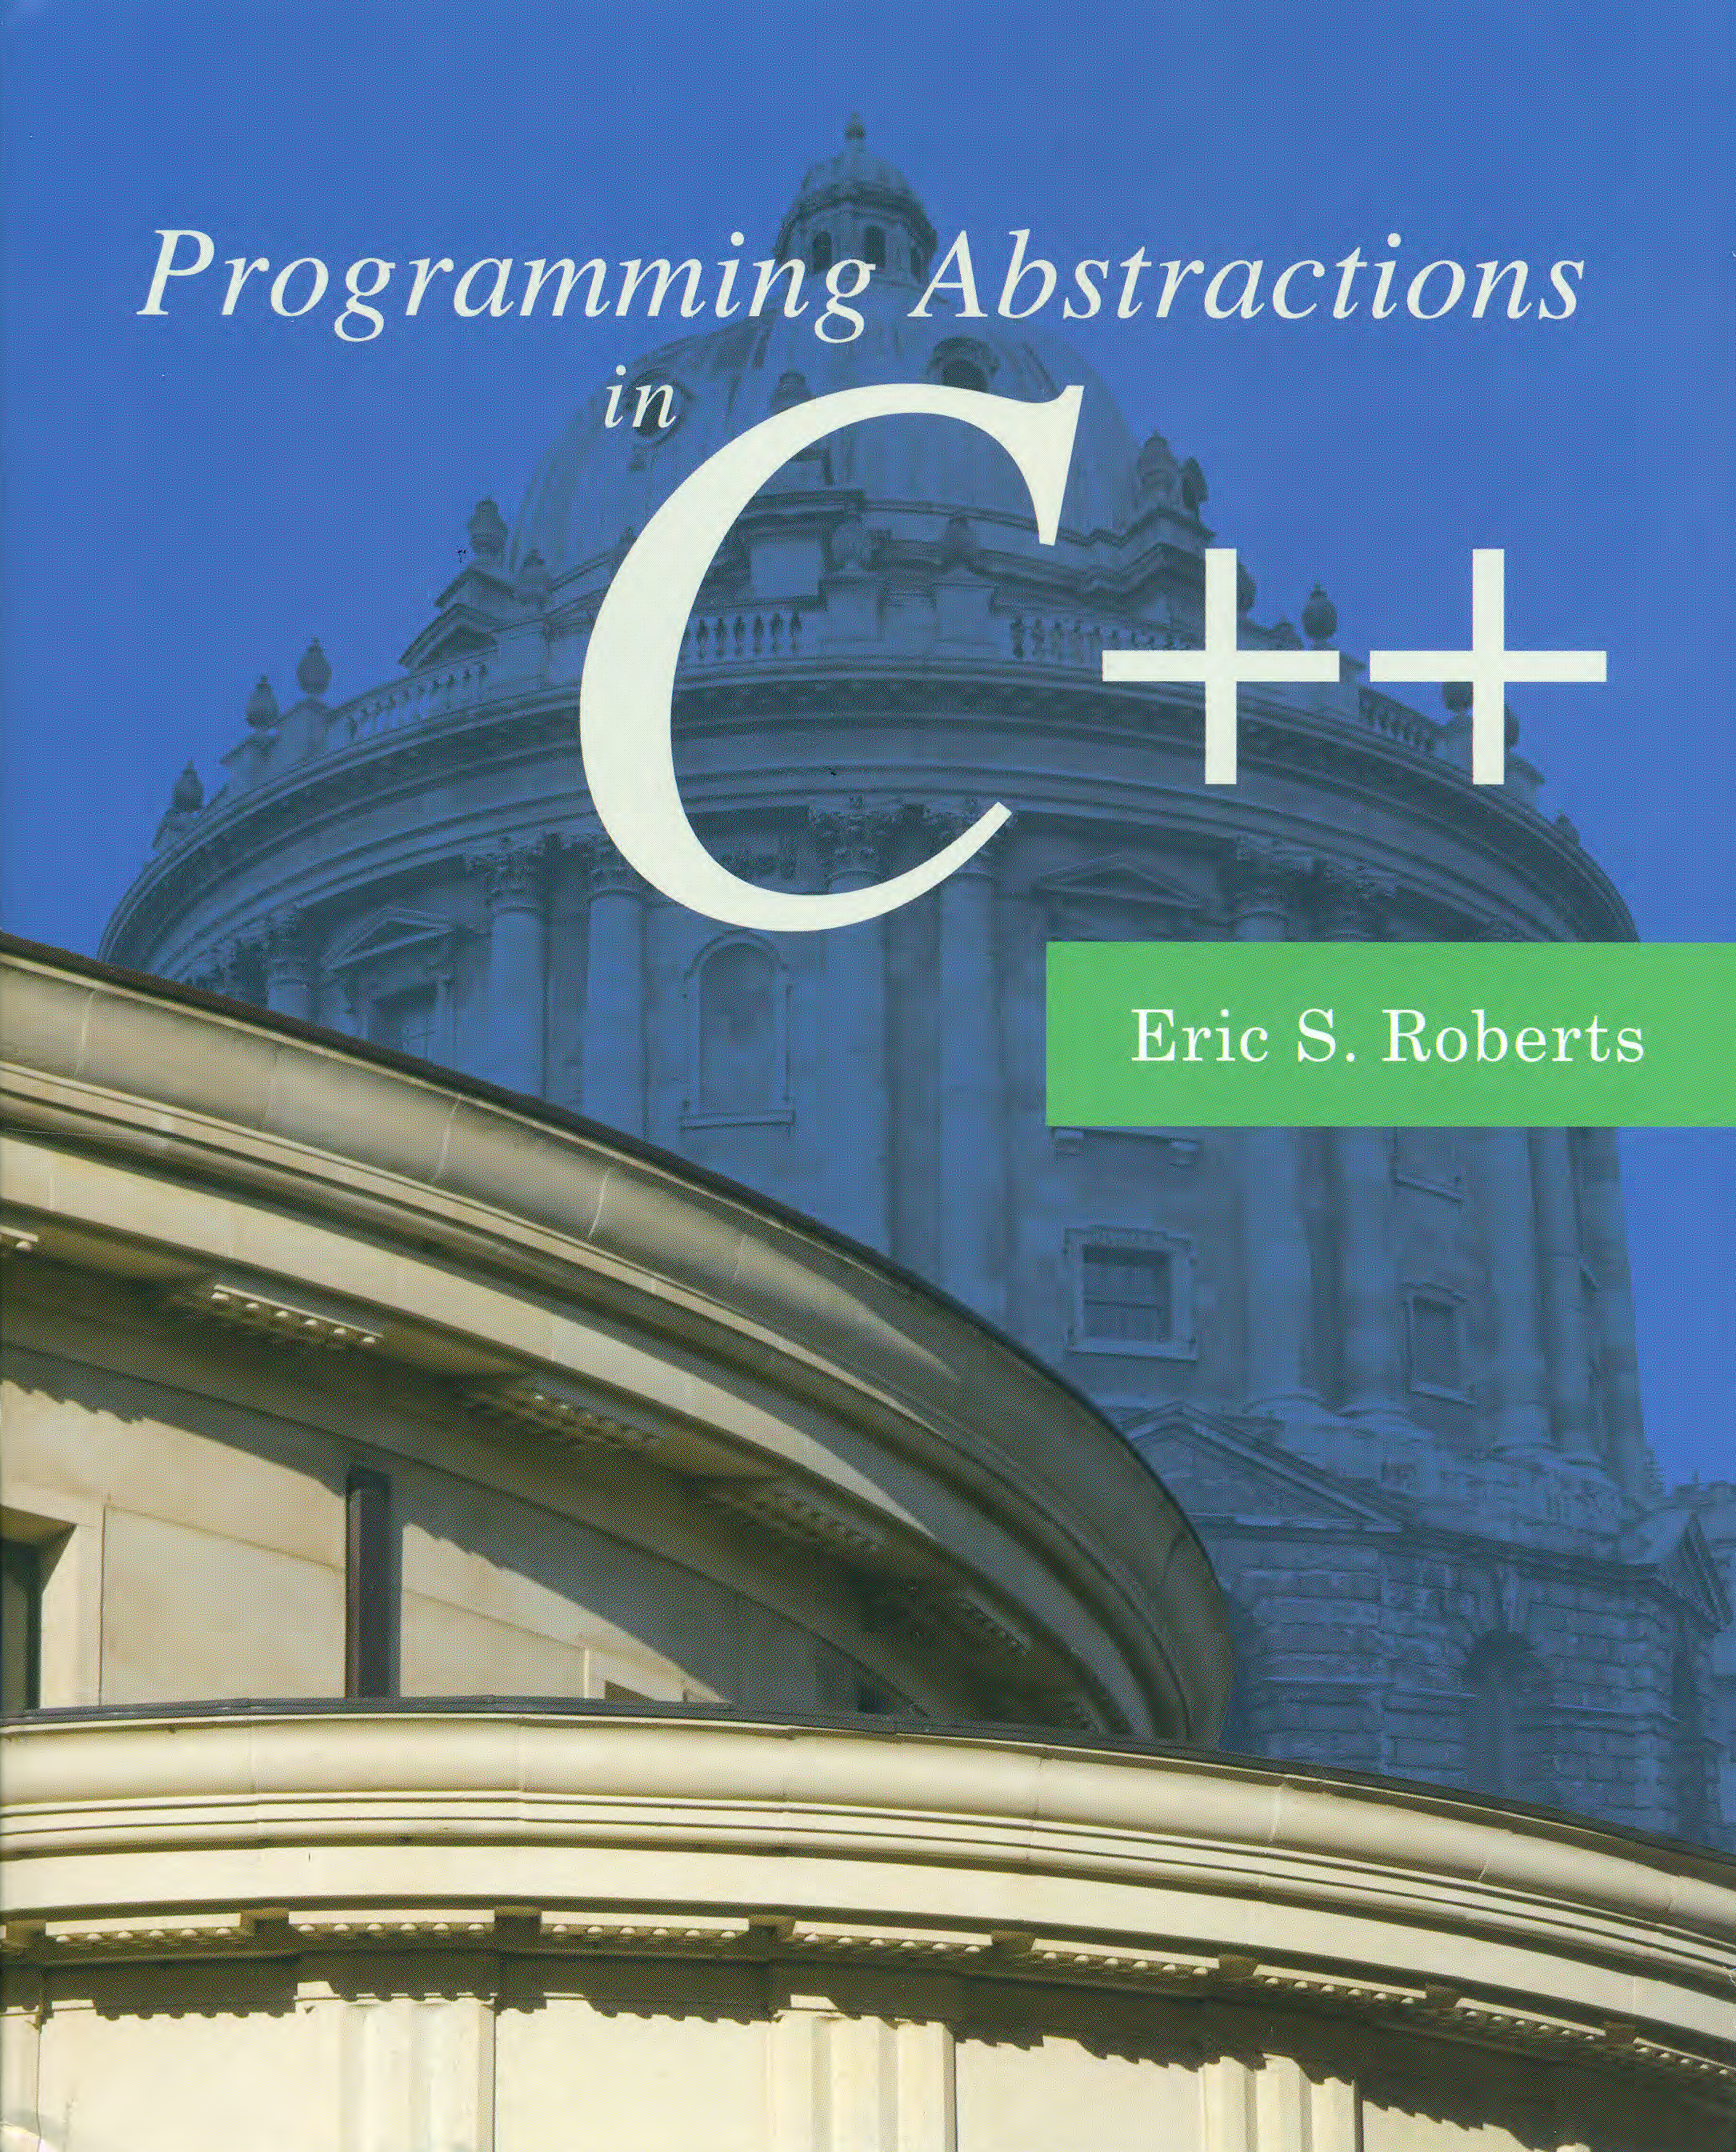
Backtracking Algorithms
C H A P T E R 9
Truth is not discovered by proofs but by exploration. It is always experimental.
—Simone Weil, The New York Notebook, 1942
9.1 Recursive backtracking in a maze
9.2 Searching in a branching structure
9.3 Backtracking and games
9.4 The minimax algorithm

Slide 2
Recursive Backtracking
For many real-world problems, the solution process consists of working your way through a sequence of decision points in which each choice leads you further along some path. If you reach a dead end or otherwise discover that you have made an incorrect choice somewhere along the way, you have to backtrack to a previous decision point and try a different path. Algorithms that use this approach are called backtracking algorithms.
If you think about a backtracking algorithm as the process of repeatedly exploring paths until you encounter the solution, the process appears to have an iterative character. As it happens, however, most problems of this form are easier to solve recursively. The fundamental recursive insight is simply this: a backtracking problem has a solution if and only if at least one of the smaller backtracking problems that result from making each possible initial choice has a solution.

Slide 3
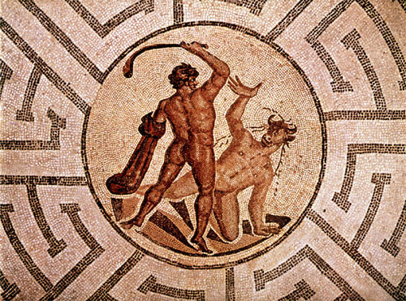
Solving a Maze
A journey of a thousand miles begins with a single step.
—Lao Tzu, 6th century B.C.E.
The example most often used to illustrate recursive backtracking is the problem of solving a maze, which has a long history in its own right.
The most famous maze in history is the labyrinth of Daedalus in Greek mythology where Theseus slays the Minotaur.
There are passing references to this story in Homer, but the best known account comes from Ovid in Metamorphoses.
Metamorphoses
—Ovid, 1 A.C.E.
. . . When Minos, willing to conceal the shame
That sprung from the reports of tatling Fame,
Resolves a dark inclosure to provide,
And, far from sight, the two-form’d creature hide.
Great Daedalus of Athens was the man
That made the draught, and form’d the wondrous plan;
Where rooms within themselves encircled lye,
With various windings, to deceive the eye. . . .
Such was the work, so intricate the place,
That scarce the workman all its turns cou’d trace;
And Daedalus was puzzled how to find
The secret ways of what himself design’d.
These private walls the Minotaur include,
Who twice was glutted with Athenian blood:
But the third tribute more successful prov’d,
Slew the foul monster, and the plague remov’d.
When Theseus, aided by the virgin’s art,
Had trac’d the guiding thread thro’ ev’ry part,
He took the gentle maid, that set him free,
And, bound for Dias, cut the briny sea.
There, quickly cloy’d, ungrateful, and unkind,
Left his fair consort in the isle behind . . .

Slide 4
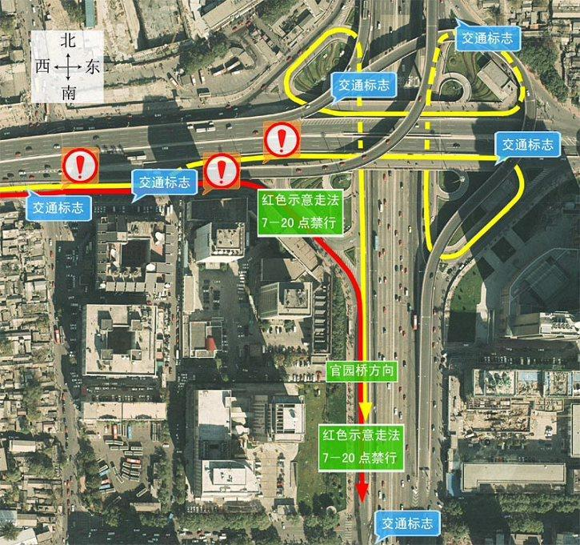
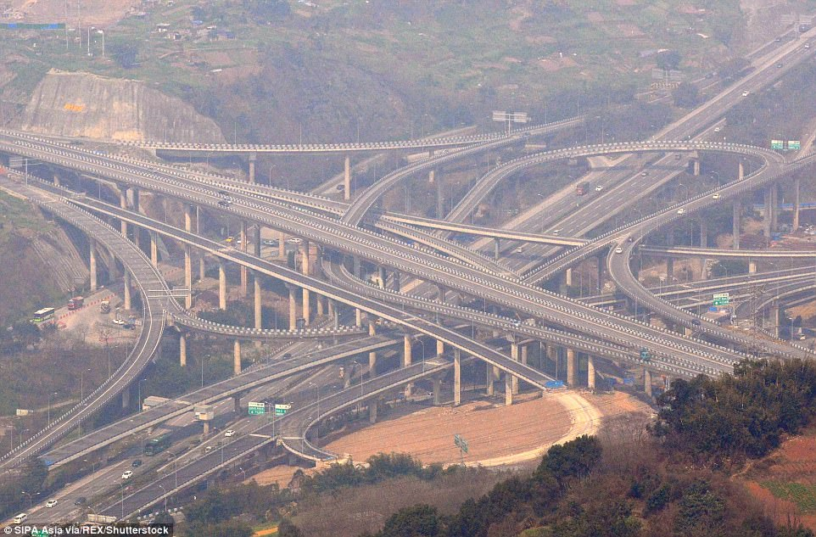
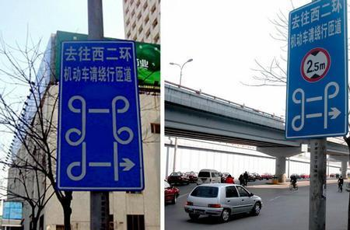

Solving a Maze
A journey of a thousand miles begins with a single step.
—Lao Tzu, 6th century B.C.E.

Slide 5
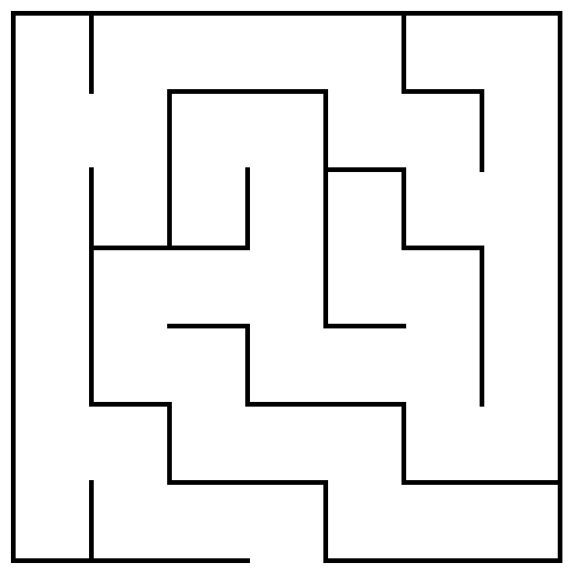
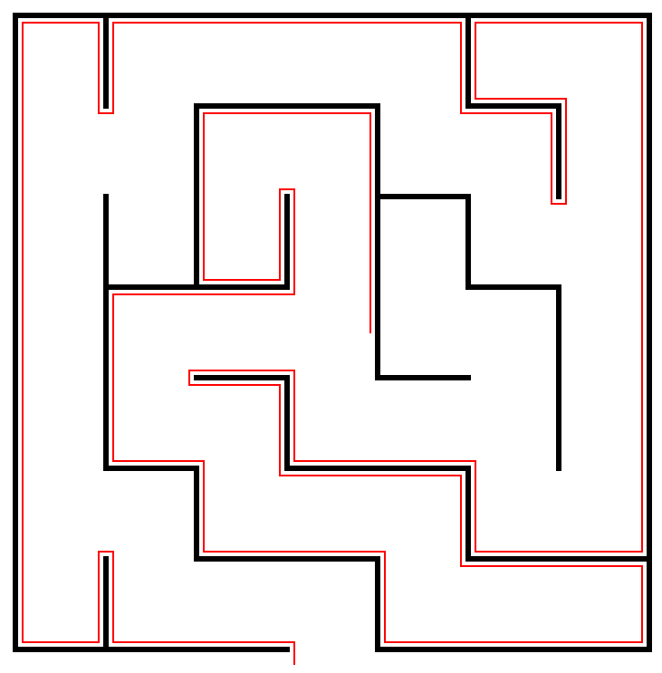
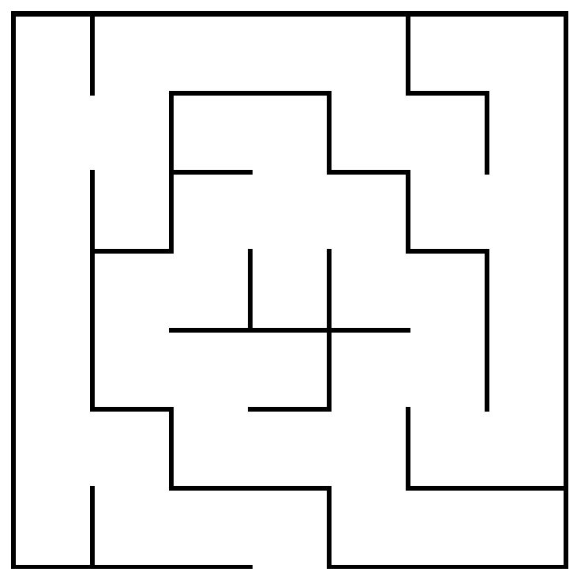
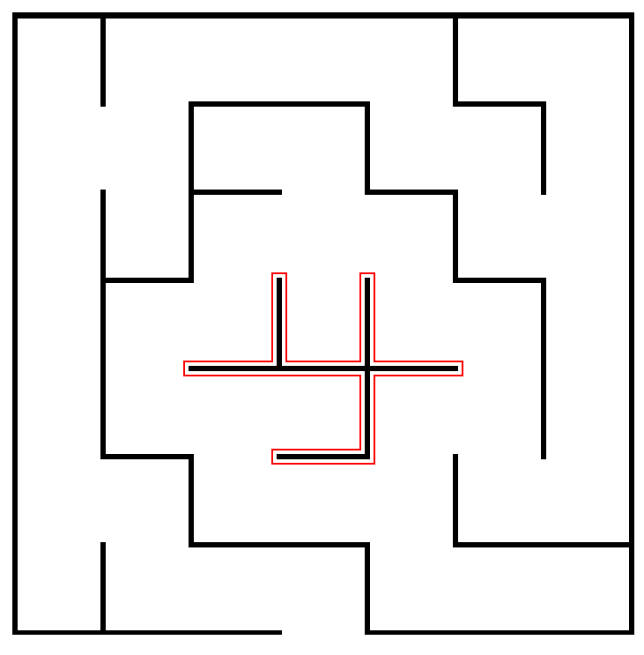
The Right-Hand Rule
The most widely known strategy for solving a maze is called the right-hand rule, in which you put your right hand on the wall and keep it there until you find an exit.
If Theseus applies the right-hand rule in this maze, the solution path looks like this.
Unfortunately, the right-hand rule doesn’t work if there are loops in the maze that surround either the starting position or the goal.
In this maze, the right-hand rule sends Theseus into an infinite loop.
Θ
Θ
Θ

Slide 6
A Recursive View of Mazes
It is also possible to solve a maze recursively. Before you can do so, however, you have to find the right recursive insight.
Consider the maze shown at the right. How can Theseus transform the problem into one of solving a simpler maze?
The insight you need is that a maze is solvable only if it is possible to solve one of the simpler mazes that results from shifting the starting location to an adjacent square and taking the current square out of the maze completely.
Θ

Slide 7
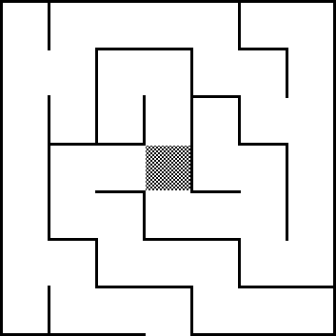
A Recursive View of Mazes
Thus, the original maze is solvable only if one of the three mazes at the bottom of this slide is solvable.
Each of these mazes is “simpler” because it contains fewer squares.
The simple cases are:
Theseus is outside the maze
There are no directions left to try
Θ
Θ
Θ
Θ

Slide 8
Enumerated Types in C++
It is often convenient to define new types in which the possible values are chosen from a small set of possibilities. Such types are called enumerated types.
In C++, you define an enumerated type like this:
The code for the maze program uses enum to define a new type consisting of the four compass points, as follows:
You can then declare a variable of type Direction and use it along with the constants NORTH, EAST, SOUTH, and WEST.
enum name { list of element names };
enum Direction {
NORTH, EAST, SOUTH, WEST
};

Slide 9
The Maze Class
/*
* Class: Maze
* -----------
* This class represents a two-dimensional maze contained in a rectangular
* grid of squares. The maze is read in from a data file in which the
* characters '+', '-', and '|' represent corners, horizontal walls, and
* vertical walls, respectively; spaces represent open passageway squares.
* The starting position is indicated by the character 'S'. For example,
* the following data file defines a simple maze:
*
* +-+-+-+-+-+
* | |
* + +-+ + +-+
* |S | |
* +-+-+-+-+-+
*/
class Maze {
public:

Slide 10
The Maze Class
/*
* Class: Maze
* -----------
* This class represents a two-dimensional maze contained in a rectangular
* grid of squares. The maze is read in from a data file in which the
* characters '+', '-', and '|' represent corners, horizontal walls, and
* vertical walls, respectively; spaces represent open passageway squares.
* The starting position is indicated by the character 'S'. For example,
* the following data file defines a simple maze:
*
* +-+-+-+-+-+
* | |
* + +-+ + +-+
* |S | |
* +-+-+-+-+-+
*/
class Maze {
public:
/*
* Constructor: Maze
* Usage: Maze maze(filename);
* Maze maze(filename, gw);
* -------------------------------
* Constructs a new maze by reading the specified data file. If the
* second argument is supplied, the maze is displayed in the center
* of the graphics window.
*/
Maze(std::string filename);
Maze(std::string filename, GWindow & gw);
/*
* Method: getStartPosition
* Usage: Point start = maze.getStartPosition();
* ---------------------------------------------
* Returns a Point indicating the coordinates of the start square.
*/
Point getStartPosition();

Slide 11
The Maze Class
/*
* Constructor: Maze
* Usage: Maze maze(filename);
* Maze maze(filename, gw);
* -------------------------------
* Constructs a new maze by reading the specified data file. If the
* second argument is supplied, the maze is displayed in the center
* of the graphics window.
*/
Maze(std::string filename);
Maze(std::string filename, GWindow & gw);
/*
* Method: getStartPosition
* Usage: Point start = maze.getStartPosition();
* ---------------------------------------------
* Returns a Point indicating the coordinates of the start square.
*/
Point getStartPosition();
/*
* Method: isOutside
* Usage: if (maze.isOutside(pt)) . . .
* ------------------------------------
* Returns true if the specified point is outside the boundary of the maze.
*/
bool isOutside(Point pt);
/*
* Method: wallExists
* Usage: if (maze.wallExists(pt, dir)) . . .
* ------------------------------------------
* Returns true if there is a wall in direction dir from the square at pt.
*/
bool wallExists(Point pt, Direction dir);
/*
* Method: markSquare
* Usage: maze.markSquare(pt);
* ---------------------------
* Marks the specified square in the maze.
*/
void markSquare(Point pt);

Slide 12
The Maze Class
/*
* Method: isOutside
* Usage: if (maze.isOutside(pt)) . . .
* ------------------------------------
* Returns true if the specified point is outside the boundary of the maze.
*/
bool isOutside(Point pt);
/*
* Method: wallExists
* Usage: if (maze.wallExists(pt, dir)) . . .
* ------------------------------------------
* Returns true if there is a wall in direction dir from the square at pt.
*/
bool wallExists(Point pt, Direction dir);
/*
* Method: markSquare
* Usage: maze.markSquare(pt);
* ---------------------------
* Marks the specified square in the maze.
*/
void markSquare(Point pt);
/*
* Method: unmarkSquare
* Usage: maze.unmarkSquare(pt);
* -----------------------------
* Unmarks the specified square in the maze.
*/
void unmarkSquare(Point pt);
/*
* Method: isMarked
* Usage: if (maze.isMarked(pt)) . . .
* -----------------------------------
* Returns true if the specified square is marked.
*/
bool isMarked(Point pt);
/* Private section goes here */
};

Slide 13
The Maze Class
private:
/* Structure representing a single square */
struct Square {
bool marked;
bool walls[4];
};
/* Instance variables */
Grid<Square> maze;
Point startSquare;
bool mazeShown;
double x0;
double y0;
int rows;
int cols;
/* Private functions go here */

Slide 14
The solveMaze Function
/*
* Function: solveMaze
* Usage: solveMaze(maze, start);
* ------------------------------
* Attempts to generate a solution to the current maze from the specified
* start point. The solveMaze function returns true if the maze has a
* solution and false otherwise. The implementation uses recursion
* to solve the submazes that result from marking the current square
* and moving one step along each open passage.
*/
bool solveMaze(Maze & maze, Point start) {
if (maze.isOutside(start)) return true;
if (maze.isMarked(start)) return false;
maze.markSquare(start);
for (Direction dir = NORTH; dir <= WEST; dir++) {
if (!maze.wallExists(start, dir)) {
if (solveMaze(maze, adjacentPoint(start, dir))) {
return true;
}
}
}
maze.unmarkSquare(start);
return false;
}

Slide 15
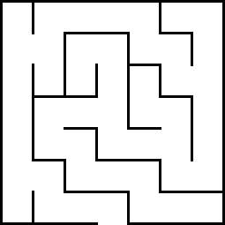

Tracing the solveMaze Function
bool solveMaze(Maze & maze, Point start) {
if (maze.isOutside(start)) return true;
if (maze.isMarked(start)) return false;
maze.markSquare(start);
for (Direction dir = NORTH; dir <= WEST; dir++) {
if (!maze.wallExists(start, dir)) {
if (solveMaze(maze, adjPt(start, dir))) {
return true;
}
}
}
maze.unmarkSquare(start);
return false;
}
x
x
x
x
x
x
x
bool solveMaze(Maze & maze, Point start) {
if (maze.isOutside(start)) return true;
if (maze.isMarked(start)) return false;
maze.markSquare(start);
for (Direction dir = NORTH; dir <= WEST; dir++) {
if (!maze.wallExists(start, dir)) {
if (solveMaze(maze, adjPt(start, dir))) {
return true;
}
}
}
maze.unmarkSquare(start);
return false;
}
bool solveMaze(Maze & maze, Point start) {
if (maze.isOutside(start)) return true;
if (maze.isMarked(start)) return false;
maze.markSquare(start);
for (Direction dir = NORTH; dir <= WEST; dir++) {
if (!maze.wallExists(start, dir)) {
if (solveMaze(maze, adjPt(start, dir))) {
return true;
}
}
}
maze.unmarkSquare(start);
return false;
}
x
x
x
x
x
x
x
x
x
x
x
x
x
Θ
x
x
x
Θ
x
x
x
x
x
Θ
x
x
x
x
x
x
x
Θ
start
dir
dir
(3, 3)
EAST
SOUTH
EAST
SOUTH
NORTH
start
NORTH
start
dir
dir
(3, 2)
(3, 4)
Don’t follow the recursion more than one level.
Depend on the recursive leap of faith.

Slide 16
Exercise: Keeping Track of the Path
As described in Exercise 3 in Chapter 9 in the text, it is possible to build a better version of solveMaze so that it keeps track of the solution path as the computation proceeds.
Write a new function:
that records the solution path in a vector of Point values passed as a reference parameter. The findSolutionPath function should return a Boolean value indicating whether the maze is solvable, just as solveMaze does.
bool findSolutionPath(Maze & maze, Point start,
Vector<Point> & path);

Slide 17
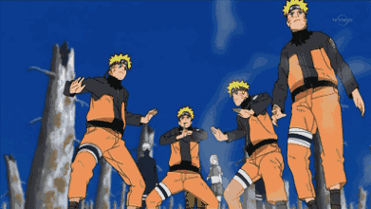
Recursion and Concurrency
The recursive decomposition of a maze generates a series of independent submazes; the goal is to solve any one of them.
If you had a multiprocessor computer, you could try to solve each of these submazes in parallel. This strategy is analogous to cloning yourself at each intersection and sending one clone down each path.
Is this parallel strategy more efficient? 1 million dollar question.
6
5
5
5
5
4
4
6
5
1
1
5
5
4
7
5
1
1
2
5
4
7
3
3
1
2
2
4
Θ
7
3
3
2
2
2
4
7
7
3
3
3
4
4
8
7
7
7
3
3
3
7

Slide 18
Reflections on the Maze Problem
The solveMaze program is a useful example of how to search all paths that stem from a branching series of choices. At each square, the solveMaze program calls itself recursively to find a solution from one step further along the path.
To give yourself a better sense of why recursion is important in this problem, think for a minute or two about what it buys you and why it would be difficult to solve this problem iteratively.
In particular, how would you answer the following questions:
What information does the algorithm need to remember as it proceeds with the solution, particularly about the options it has already tried?
In the recursive solution, where is this information kept?
How might you keep track of this information otherwise?

Slide 19
Consider a Specific Example
Suppose that the program has reached the following position:
How does the algorithm keep track of the “big picture” of what paths it still needs to explore?
x
Θ
x
x
x
x

Slide 20
Each Frame Remembers One Choice
bool solveMaze(Maze & maze, Point start) {
if (maze.isOutside(start)) return true;
if (maze.isMarked(start)) return false;
maze.markSquare(start);
for (Direction dir = NORTH; dir <= WEST; dir++) {
if (!maze.wallExists(start, dir)) {
if (solveMaze(maze, adjPt(start, dir))) {
return true;
}
}
}
maze.unmarkSquare(start);
return false;
}
bool solveMaze(Maze & maze, Point start) {
if (maze.isOutside(start)) return true;
if (maze.isMarked(start)) return false;
maze.markSquare(start);
for (Direction dir = NORTH; dir <= WEST; dir++) {
if (!maze.wallExists(start, dir)) {
if (solveMaze(maze, adjPt(start, dir))) {
return true;
}
}
}
maze.unmarkSquare(start);
return false;
}
bool solveMaze(Maze & maze, Point start) {
if (maze.isOutside(start)) return true;
if (maze.isMarked(start)) return false;
maze.markSquare(start);
for (Direction dir = NORTH; dir <= WEST; dir++) {
if (!maze.wallExists(start, dir)) {
if (solveMaze(maze, adjPt(start, dir))) {
return true;
}
}
}
maze.unmarkSquare(start);
return false;
}
bool solveMaze(Maze & maze, Point start) {
if (maze.isOutside(start)) return true;
if (maze.isMarked(start)) return false;
maze.markSquare(start);
for (Direction dir = NORTH; dir <= WEST; dir++) {
if (!maze.wallExists(start, dir)) {
if (solveMaze(maze, adjPt(start, dir))) {
return true;
}
}
}
maze.unmarkSquare(start);
return false;
}
x
Θ
x
x
Θ
x
x
x
x
x
bool solveMaze(Maze & maze, Point start) {
if (maze.isOutside(start)) return true;
if (maze.isMarked(start)) return false;
maze.markSquare(start);
for (Direction dir = NORTH; dir <= WEST; dir++) {
if (!maze.wallExists(start, dir)) {
if (solveMaze(maze, adjPt(start, dir))) {
return true;
}
}
}
maze.unmarkSquare(start);
return false;
}
Θ
bool solveMaze(Maze & maze, Point start) {
if (maze.isOutside(start)) return true;
if (maze.isMarked(start)) return false;
maze.markSquare(start);
for (Direction dir = NORTH; dir <= WEST; dir++) {
if (!maze.wallExists(start, dir)) {
if (solveMaze(maze, adjPt(start, dir))) {
return true;
}
}
}
maze.unmarkSquare(start);
return false;
}
x
x
x
x
x
x
x
x
x
x
x
Θ
Θ
x
Θ
start
dir
start
dir
(3, 3)
SOUTH
(3, 4)
start
dir
EAST
(4, 4)
start
dir
EAST
(5, 4)
NORTH
start
dir
(5, 3)
start
dir
WEST
(4, 3)

Slide 21
Searching in a Branching Structure
The recursive structure for finding the solution path in a maze comes up in a wide variety of applications, characterized by the need to explore a range of possibilities at each of a series of choice points.
The primary advantage of using recursion in these problems is that doing so dramatically simplifies the bookkeeping. Each level of the recursive algorithm considers one choice point. The historical knowledge of what choices have already been tested and which ones remain for further exploration is maintained automatically in the execution stack.
Many such applications are like the maze-solving algorithm in which the process searches a branching structure to find a particular solution. Others, however, use the same basic strategy to explore every path in a branching structure in some systematic way.

Slide 22
Exercise: Generating Subsets
Write a function
that generates a vector showing all subsets of the set formed from the letters in set.
For example, calling generateSubsets("abc") should return a vector containing the following eight strings, in some order:
The solution process requires a branching structure similar to that used to solve a maze. At each level of the recursion, you can either exclude or include the current letter from the list of subsets, as illustrated on the following slide.
Vector<string> generateSubsets(string set);
""
"a"
"ab"
"abc"
"b"
"ac"
"c"
"bc"

Slide 23
The Subset Tree
The set of all subsets of { a, b, c } is
Those that don’t include 'a'
Those that do include 'a'
Has no 'b'
Has a 'b'
Has no 'b'
Has a 'b'
Has no 'c'
Has a 'c'
Has no 'c'
Has a 'c'
Has no 'c'
Has a 'c'
Has no 'c'
Has a 'c'
{ }
{ c }
{ b }
{ b, c }
{ a }
{ a, c }
{ a, b }
{ a, b, c }
Remember the inclusion-exclusion pattern?

Slide 24
Generating Subsets
/*
* Function: generateSubsets
* Usage: Vector<string> subsets = generateSubsets(str);
* -----------------------------------------------------
* Generates a vector containing all subsets of the specified
* set. Each set is represented as a string in which the letters
* correspond to the individual elements. Thus, the string
* "abd" represents the set { a, b, d }.
*/
Vector<string> generateSubsets(string set) {
Vector<string> result;
if (set == "") {
result.add("");
} else {
result = generateSubsets(set.substr(1));
int n = result.size();
for (int i = 0; i < n; i++) {
result.add(set[0] + result[i]);
}
}
return result;
}

Slide 25


The Eight Queens Problem

Slide 26

What Most Students Want to Do
bool solveQueens(Grid<char> & board) {
int n = board.numRows();
for (int c0 = 0; c0 < n; c0++) {
board[0][c0] = 'Q';
for (int c1 = 0; c1 < n; c1++) {
board[1][c1] = 'Q';
for (int c2 = 0; c2 < n; c2++) {
board[2][c2] = 'Q';
. . .
if (boardIsLegal(board)) return true;
. . .
board[2][c2] = ' ';
}
board[1][c1] = ' ';
}
board[0][c0] = ' ';
}
return false;
}

Slide 27
Exercise: Find a Recursive Solution
Assuming that you have the function boardIsLegal from the previous slide, how would you write a recursive solution that works with the following main program:
What aspect of NQueens can you use to have the recursion move toward simpler instances of some common subproblem?
int main() {
int n = getInteger("Enter size of board: ");
Grid<char> board(n, n);
for (int i = 0; i < n; i++) {
for (int j = 0; j < n; j++) {
board[i][j] = ' ';
}
}
if (solveQueens(board)) {
displayBoard(board);
} else {
cout << "There is no solution for this board" << endl;
}
return 0;
}

Slide 28
NQueens
/*
* Function: solveQueens
* Usage: bool flag = solveQueens(board, nPlaced);
* -----------------------------------------------
* Tries to solve the N-Queens problem on the specified board,
* which is already populated with nPlaced queens by earlier
* recursive calls. The function returns true if a solution is
* found, otherwise it returns false.
*/
bool solveQueens(Grid<char> & board, int nPlaced) {
int n = board.numRows();
if (nPlaced == n) return true;
for (int row = 0; row < n; row++) {
if (queenIsLegal(board, row, nPlaced)) {
board[row][nPlaced] = 'Q';
if (solveQueens(board, nPlaced + 1)) return true;
board[row][nPlaced] = ' ';
}
}
return false;
}

Slide 29
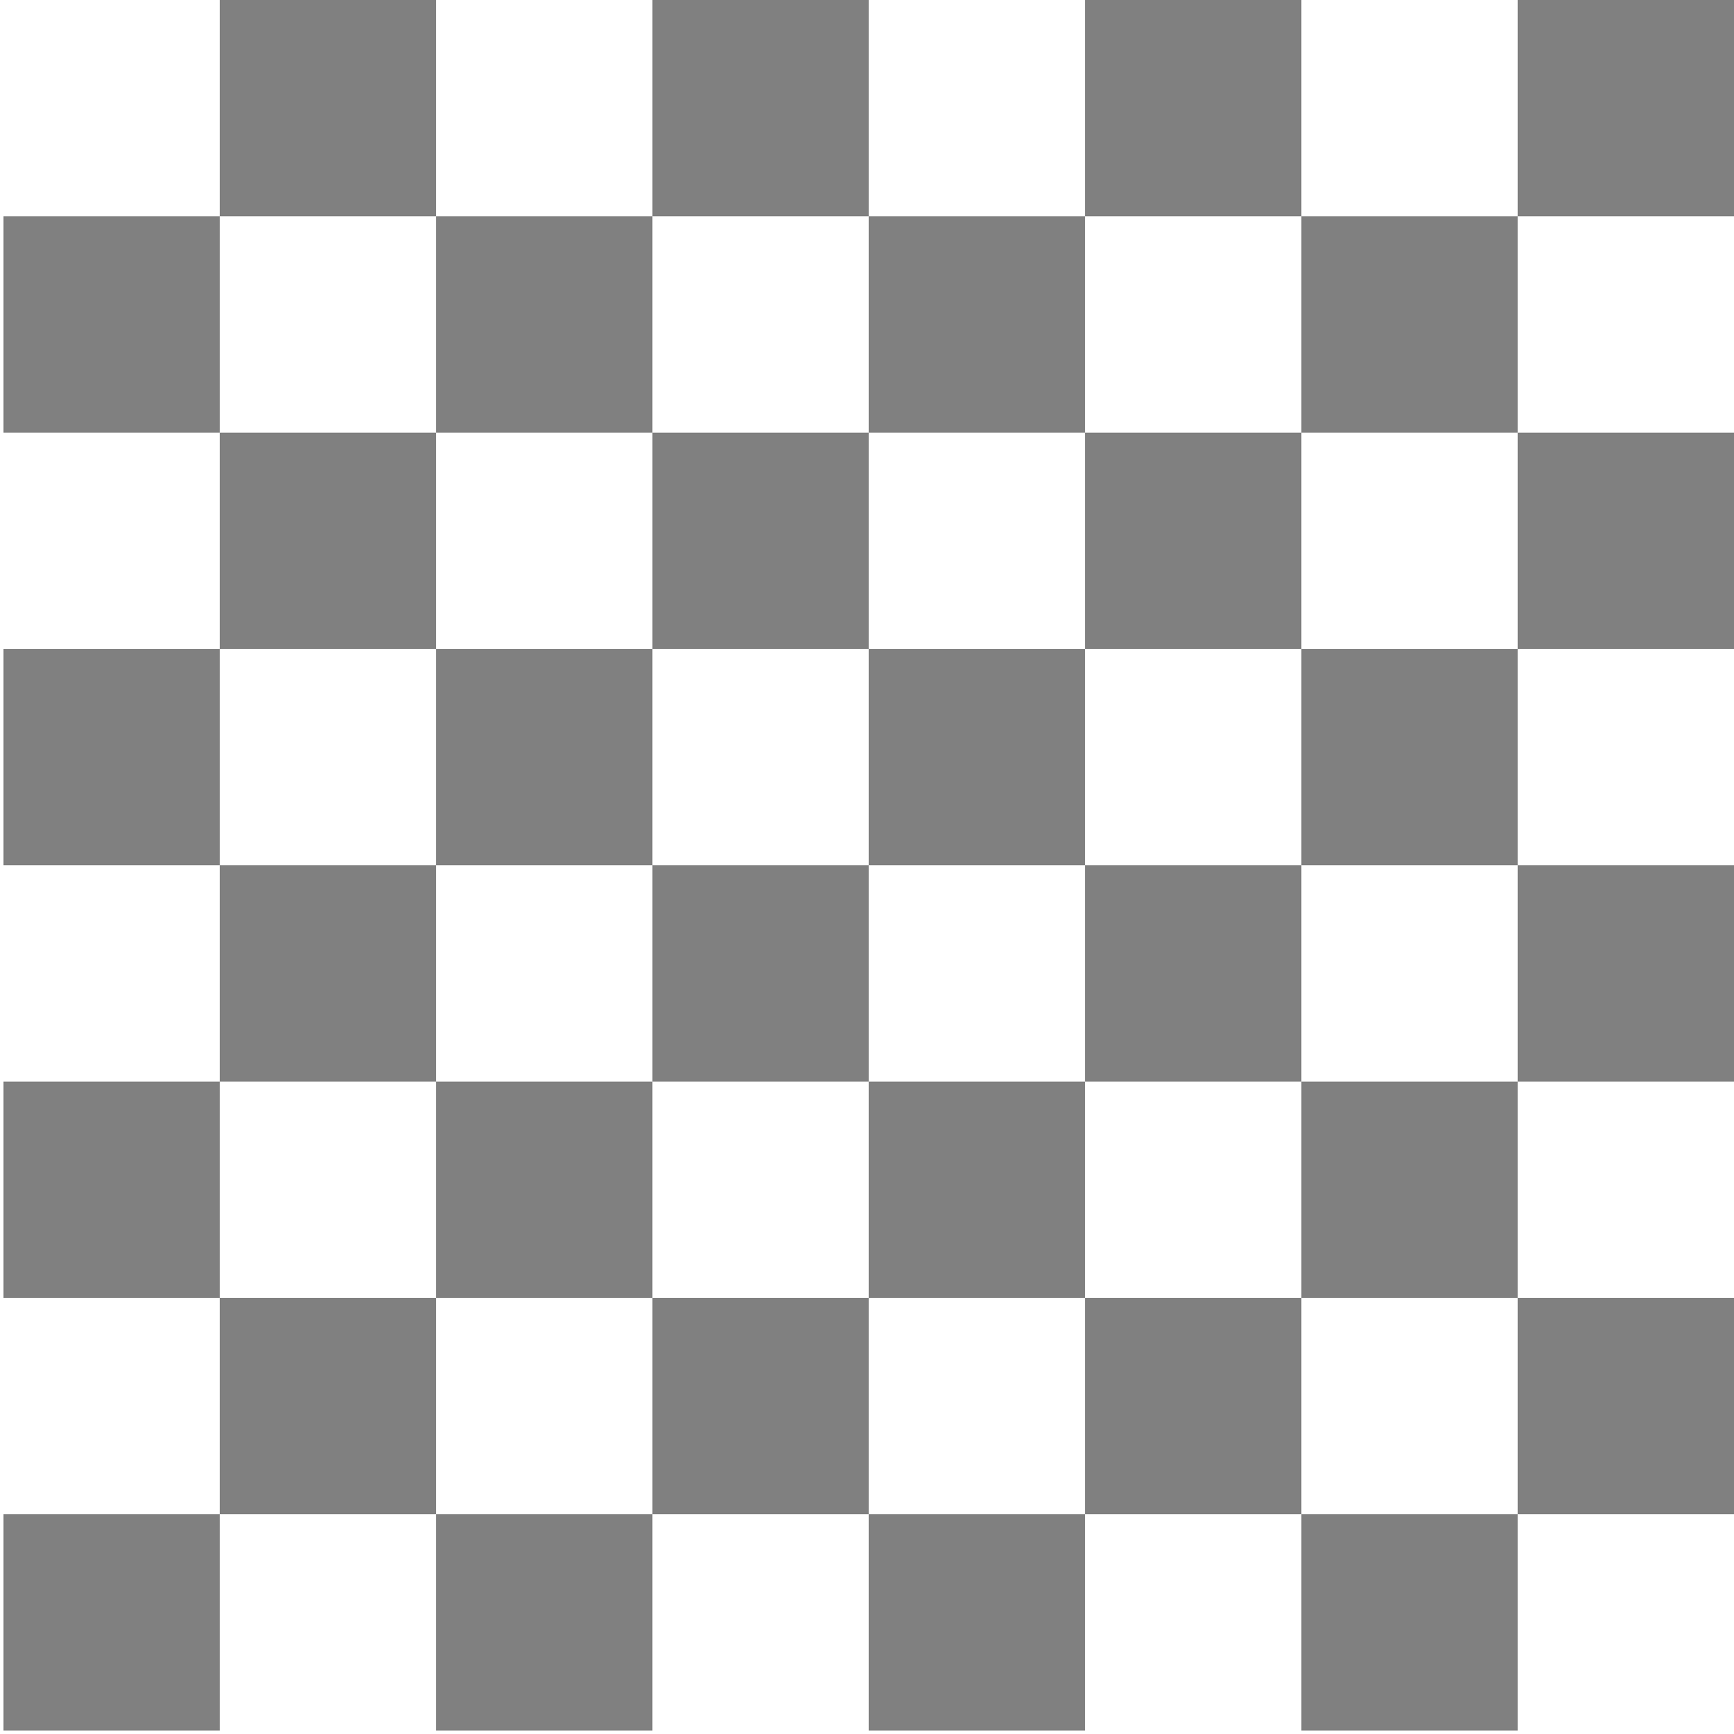












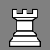





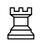
Recursion and Games
In 1950, Claude Shannon wrote an article for Scientific American in which he described how to write a chess-playing computer program.
Shannon’s strategy was to have the computer try every possible move for white, followed by all of black’s responses, and then all of white’s responses to those moves, and so on.
Even with modern computers, it is impossible to use this strategy for an entire game, because there are too many possibilities.
5
10
20
25
30
35
Positions evaluated:
53
~
1000
2000
3000
4000
5000
6000
7000
8000
9000
10
10
10
10
10
10
10
. . . millions of years later . . .

Slide 30


Deep Blue Beats Gary Kasparov
In 1997, IBM’s Deep Blue program beat Gary Kasparov, who was then the world’s human champion. In 1996, Kasparov had won in play that is in some ways more instructive.
Game 6
Kasparov
Deep Blue
30. b6
8
30. Bb8 ??
7
6
5
4
3
2
1
a
b
c
d
e
f
g
h

Slide 31
A Simpler Game
Chess is far too complex a game to serve as a useful example. The text uses a much simpler game called Nim, which is representative of a large class of two-player games.
In Nim, the game begins with a pile of coins between two players. The starting number of coins can vary and should therefore be easy to change in the program.
In alternating turns, each player takes one, two, or three coins from the pile in the center.
The player who takes the last coin loses.

Slide 32
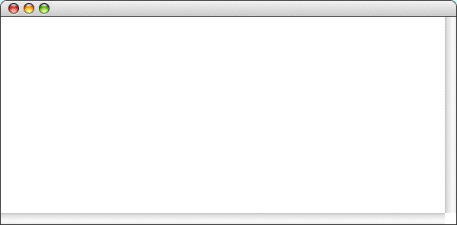
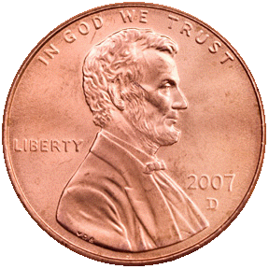
A Sample Game of Nim
Nim
There are 11 coins left.
I'll take 2.
There are 9 coins left.
Your move:
1
There are 8 coins left.
I'll take 3.
There are 5 coins left.
Your move:
2
There are 3 coins left.
I'll take 2.
There is only one coin left.
You lose.

Slide 33
Good Moves and Bad Positions
The essential insight behind the Nim program is bound up in the following mutually recursive definitions:
A good move is one that leaves your opponent in a bad position.
A bad position is one that offers no good moves.
E.g., if you ever find yourself with just one coin on the table, you’re in a bad position (you have to take that coin and lose). On the other hand, things look good if you find yourself with two, three, or four coins. In any of these cases, you can always take all but one of the remaining coins (good moves), leaving your opponent in the bad position of being stuck with just one coin.
The implementation of the Nim game is really nothing more than a translation of these definitions into code.

Slide 34
Coding the Nim Strategy
/*
* Looks for a winning move, given the specified number of coins.
* If there is a winning move in that position, findGoodMove returns
* that value; if not, the method returns the constant NO_GOOD_MOVE.
* This implementation depends on the recursive insight that a good move
* is one that leaves your opponent in a bad position and a bad position
* is one that offers no good moves.
*/
int findGoodMove(int nCoins) {
int limit = (nCoins < MAX_MOVE) ? nCoins : MAX_MOVE;
for (int nTaken = 1; nTaken <= limit; nTaken++) {
if (isBadPosition(nCoins - nTaken)) return nTaken;
}
return NO_GOOD_MOVE;
}
/*
* Returns true if nCoins is a bad position. Being left with a single
* coin is clearly a bad position and represents the simple case.
*/
bool isBadPosition(int nCoins) {
if (nCoins == 1) return true;
return findGoodMove(nCoins) == NO_GOOD_MOVE;
}

Slide 35
Coding the Nim Strategy
isBadPosition(1) true
findGoodMove(2) 1
isBadPosition(2) false
findGoodMove(3) 2
isBadPosition(3) false
findGoodMove(4) 3
isBadPosition(4) false
findGoodMove(5) NO_GOOD_MOVE
isBadPosition(5) true
...

Slide 36
A generalized program for two-player games
struct Move {
int nTaken;
};
void play() {
initGame();
while (!gameIsOver()) {
displayGame();
if (getCurrentPlayer() == HUMAN) {
makeMove(getUserMove());
} else {
Move move = getComputerMove();
displayMove(move);
makeMove(move);
}
switchTurn();
}
announceResult();
}

Slide 37
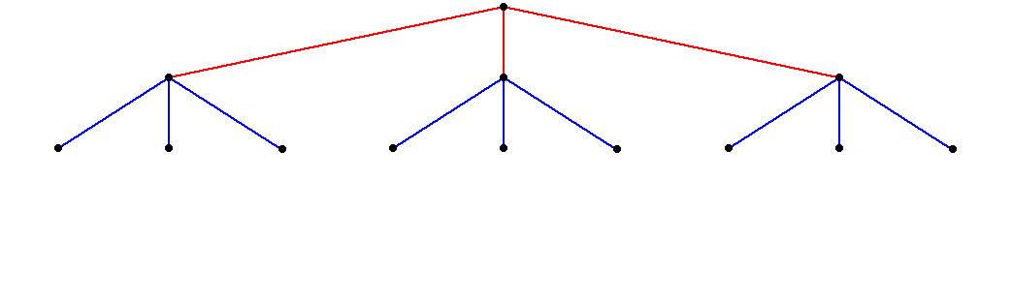
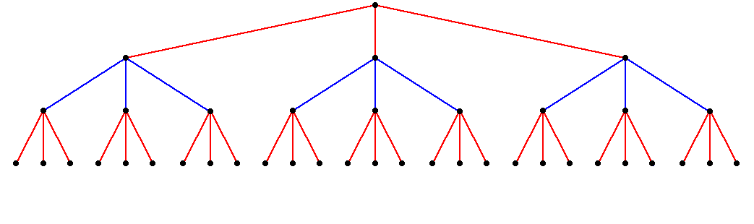
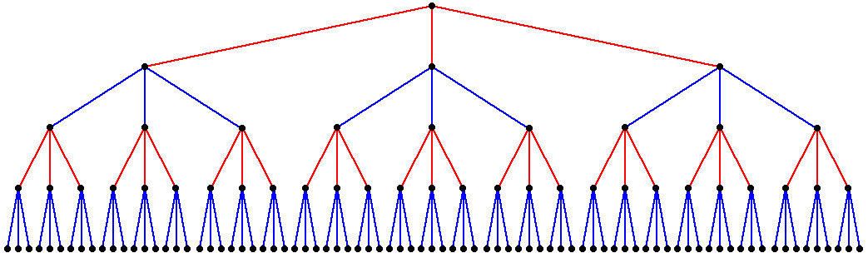
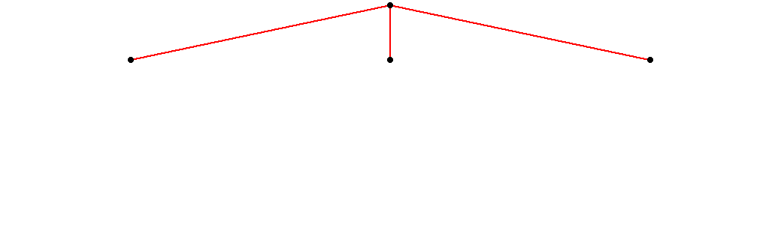
Game Trees
As Shannon observed in 1950, most two-player games have the same basic form:
The first player (red) must choose between a set of moves
For each move, the second player (blue) has several responses.
For each of these responses, red has further choices.
For each of these new responses, blue makes another decision.
And so on . . .

Slide 38
The Minimax Algorithm
Games like Nim are simple enough that it is possible to solve them completely in a relatively small amount of time.
For more complex games, it is necessary to cut off the analysis at some point and then evaluate the position, presumably using some function that looks at a position and returns a rating for that position. Positive ratings are good for the player to move; negative ones are bad.
When your game player searches the tree for best move, it can’t simply choose the one with the highest rating because you control only half the play.
What you want instead is to choose the move that minimizes the maximum rating available to your opponent. This strategy is called the minimax algorithm.

Slide 39
A Minimax Illustration
Suppose that the ratings two turns from now are as shown.
From your perspective, the +9 initially looks attractive.
Unfortunately, your can’t get there, since the –5 is better for your opponent.
The best you can do is choose the move that leads to the –2.
+7
+6
–9
–5
+9
–4
–1
+1
–2

Slide 40

AlphaGo vs. Lee Sedol

Slide 41
AlphaGo’s algorithm
AlphaGo's algorithm uses a combination of machine learning and tree search techniques, combined with extensive training, both from human and computer play.
It uses Monte Carlo tree search, guided by a "value network" and a "policy network", both implemented using deep neural network technology.
The system's neural networks were initially bootstrapped from human gameplay expertise from recorded historical games, using a database of around 30 million moves.
Once it had reached a certain degree of proficiency, it was trained further by being set to play large numbers of games against other instances of itself, using reinforcement learning to improve its play.

Slide 42
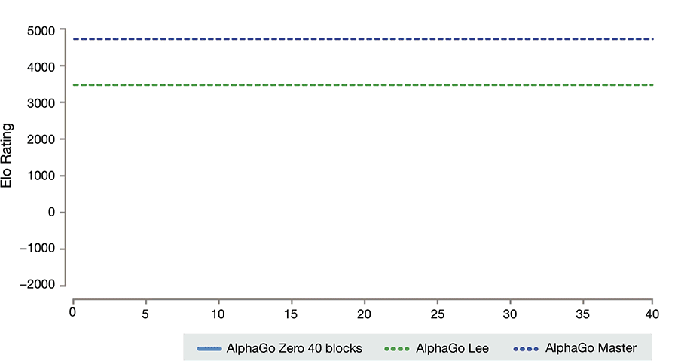
AlphaGo Zero

Slide 43

Libratus beats poker pros
What about Mahjong?

Slide 44
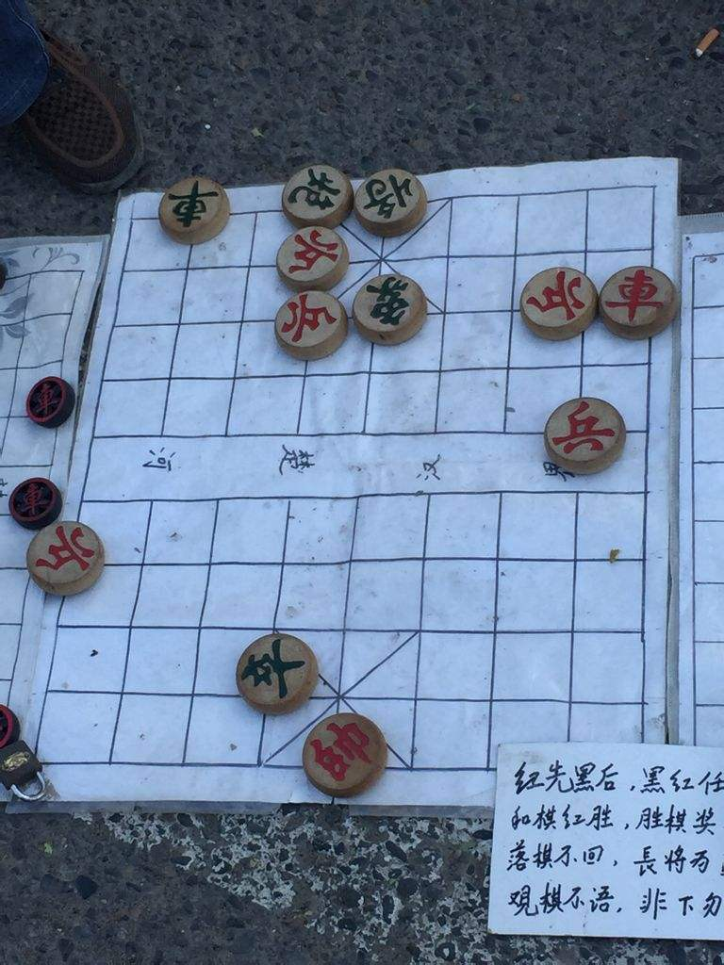
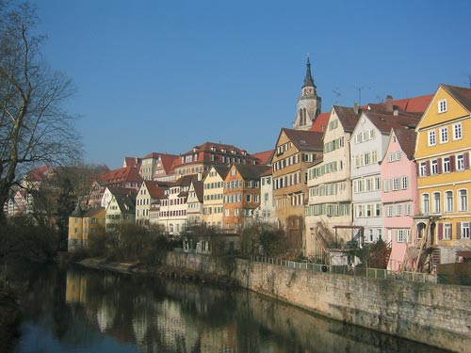
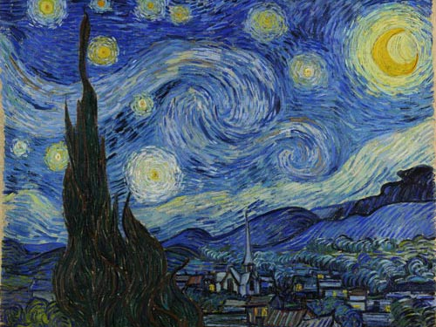
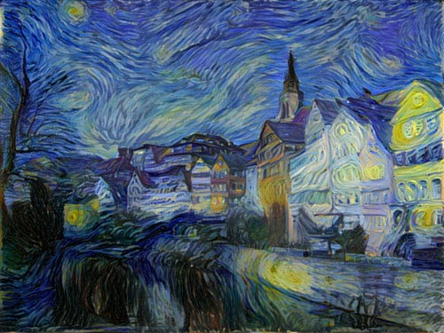
What is AI?
What is intelligence, artificial intelligence, machine intelligence…?
Is machine intelligence just pure computing power? A story about Chinese chess.
Art is about creativity. Can AI do art?
What is exactly creativity?
The infinite monkey theorem
What if we have infinite computers?

Slide 45
The End

